Slide 1
Amul Ghodasara
200493038
Link : - https://storymaps.arcgis.com/stories/c5af43dfe4bc459b88d987b9c3e411af

Slide 2
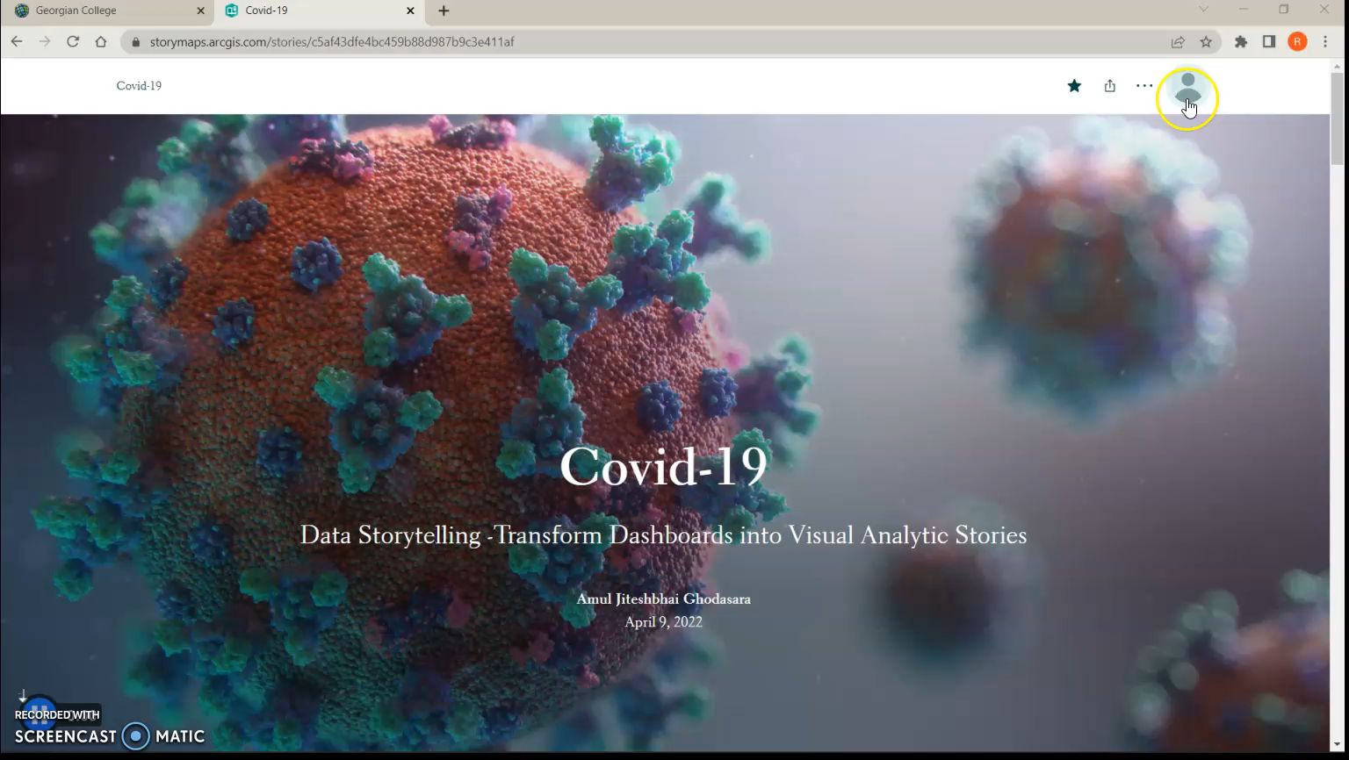
Video

Slide 3


Slide 4
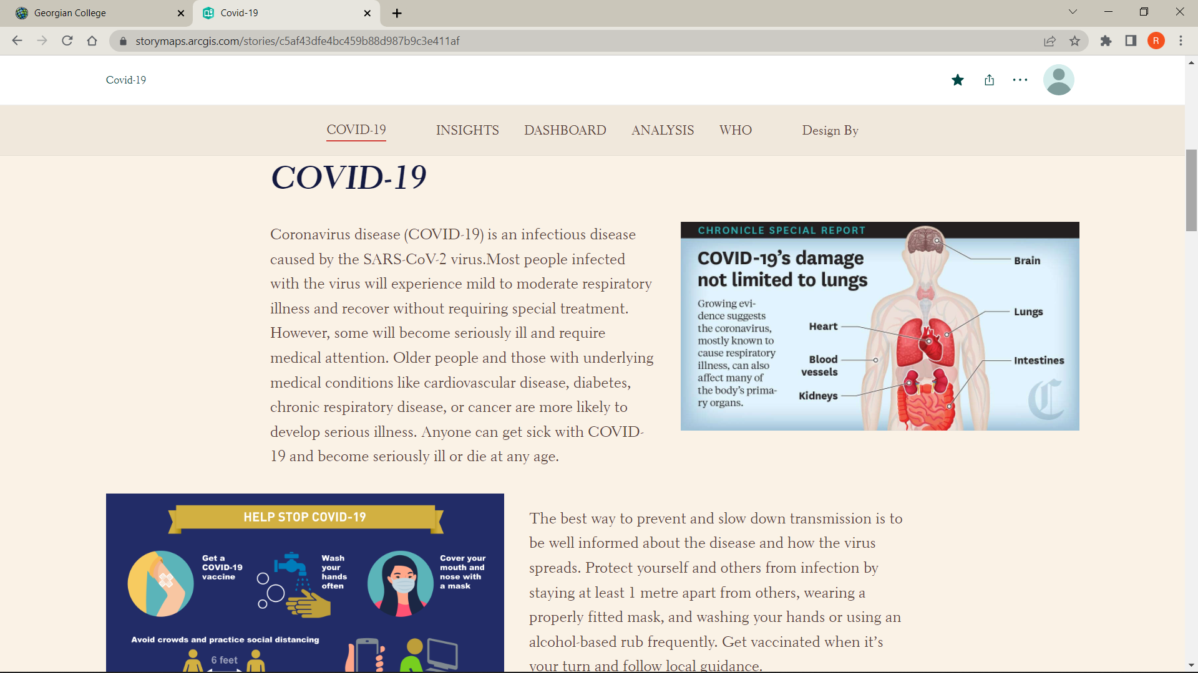

Slide 5
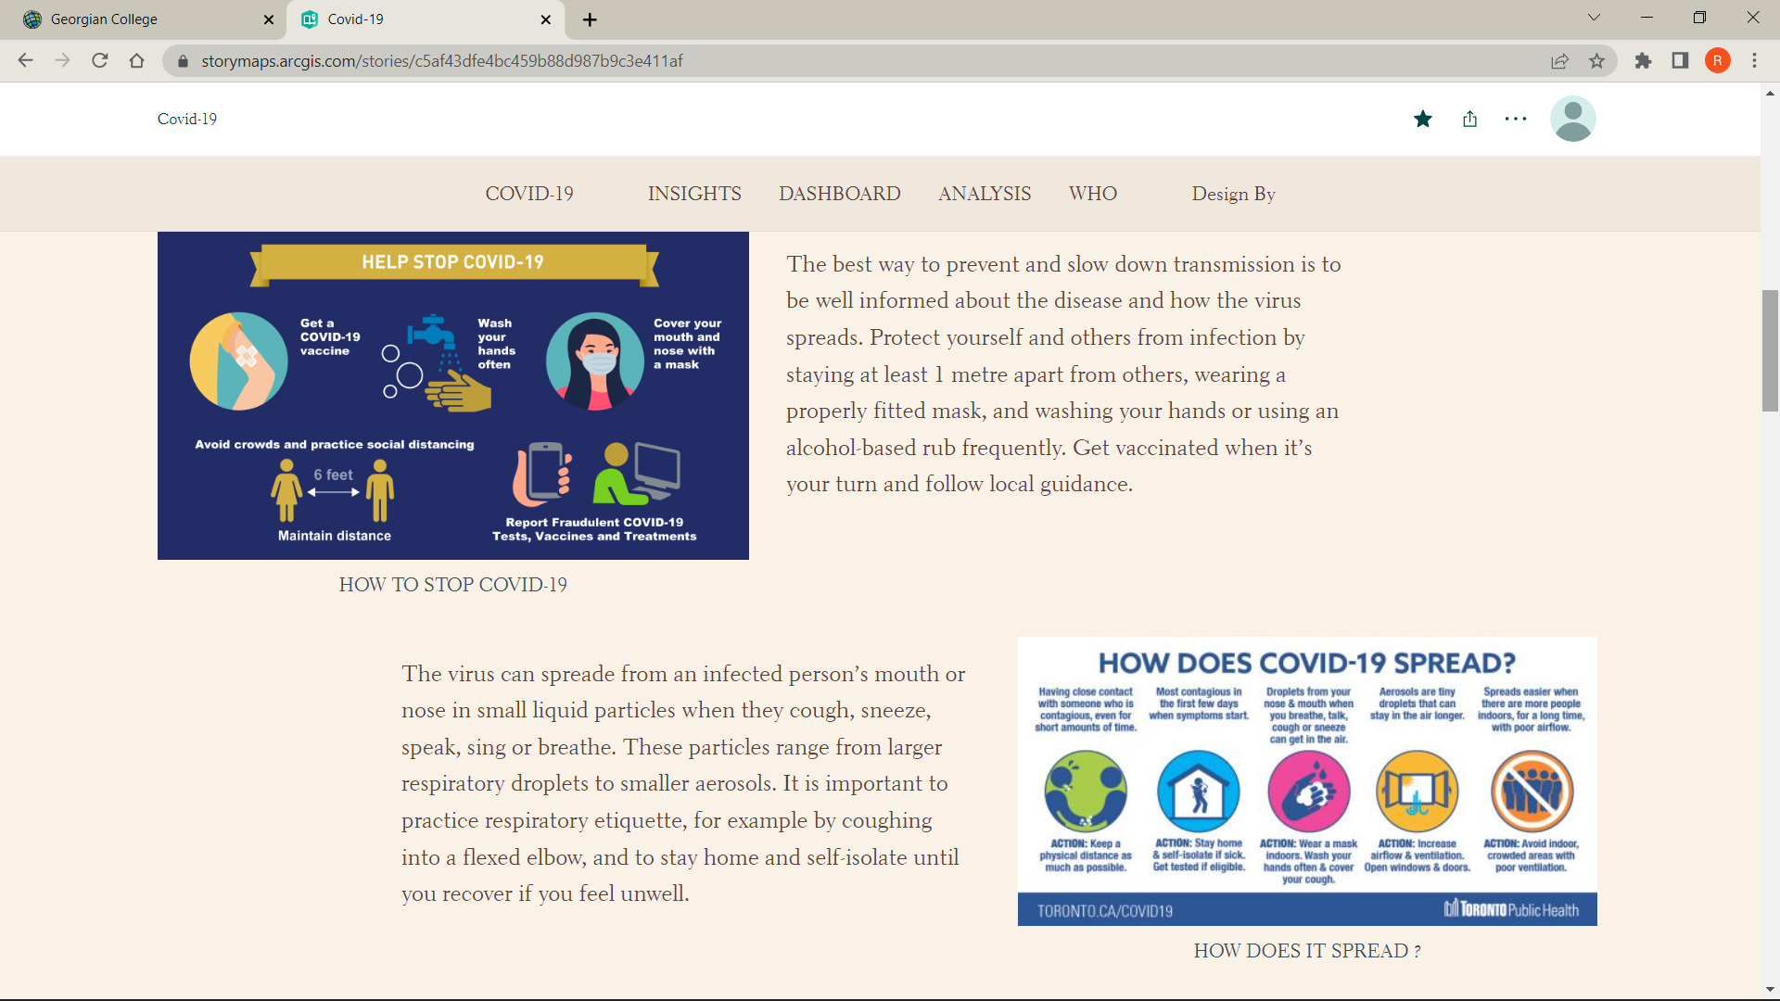

Slide 6
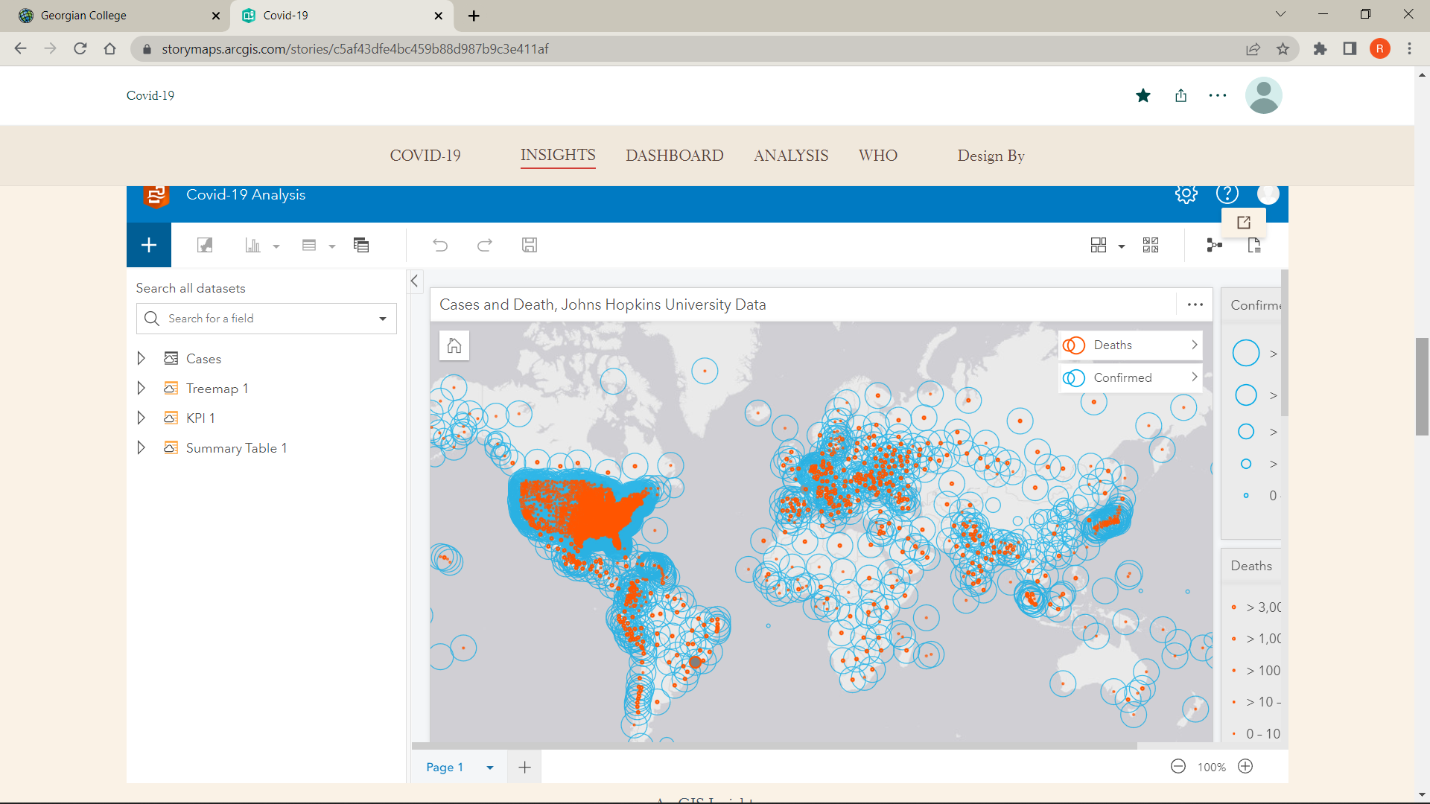

Slide 7
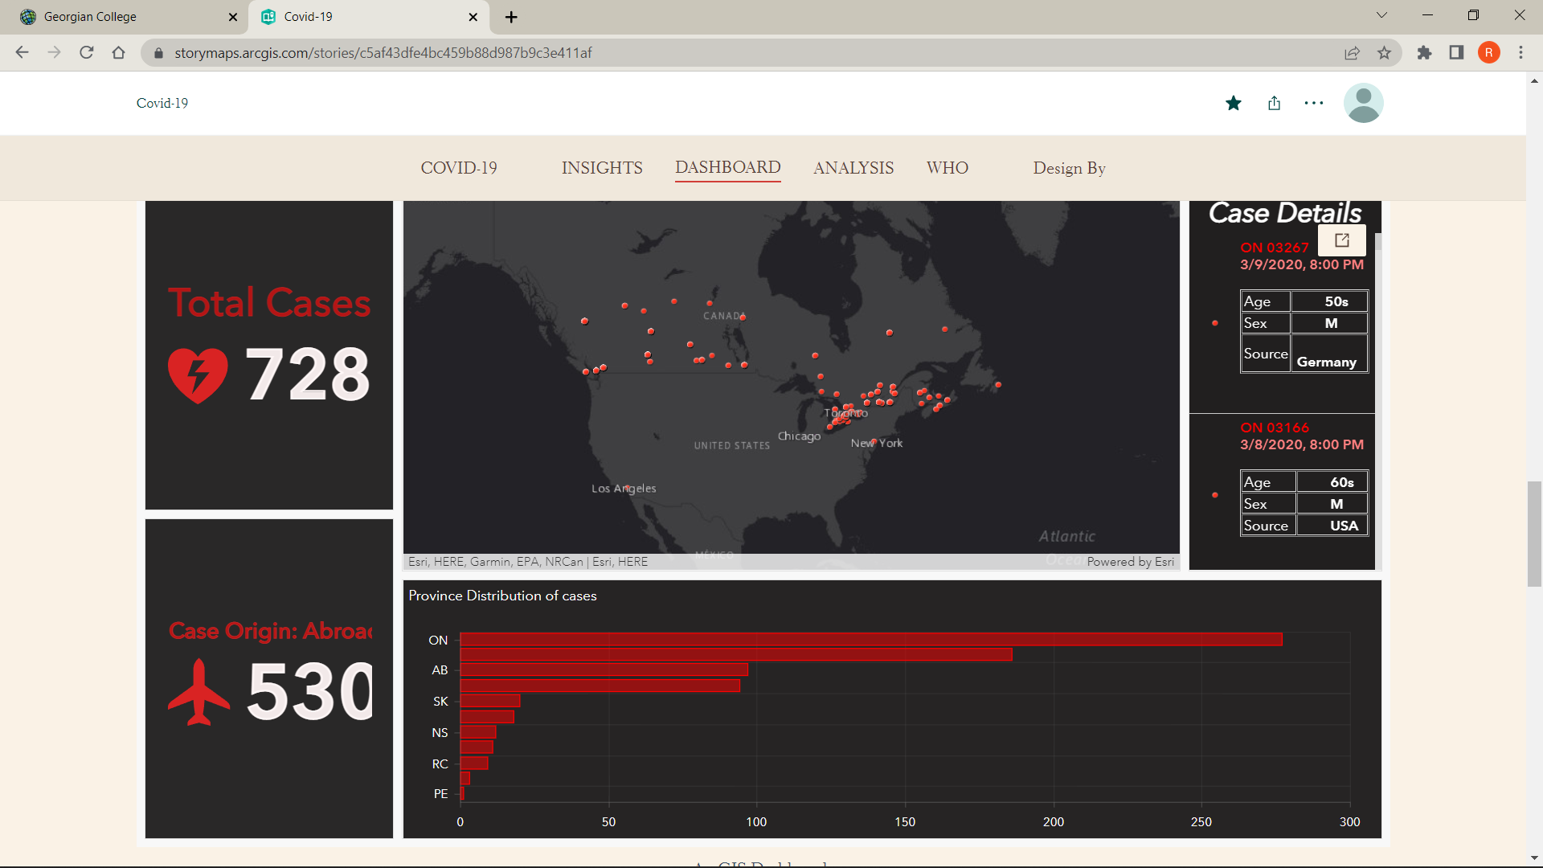

Slide 8
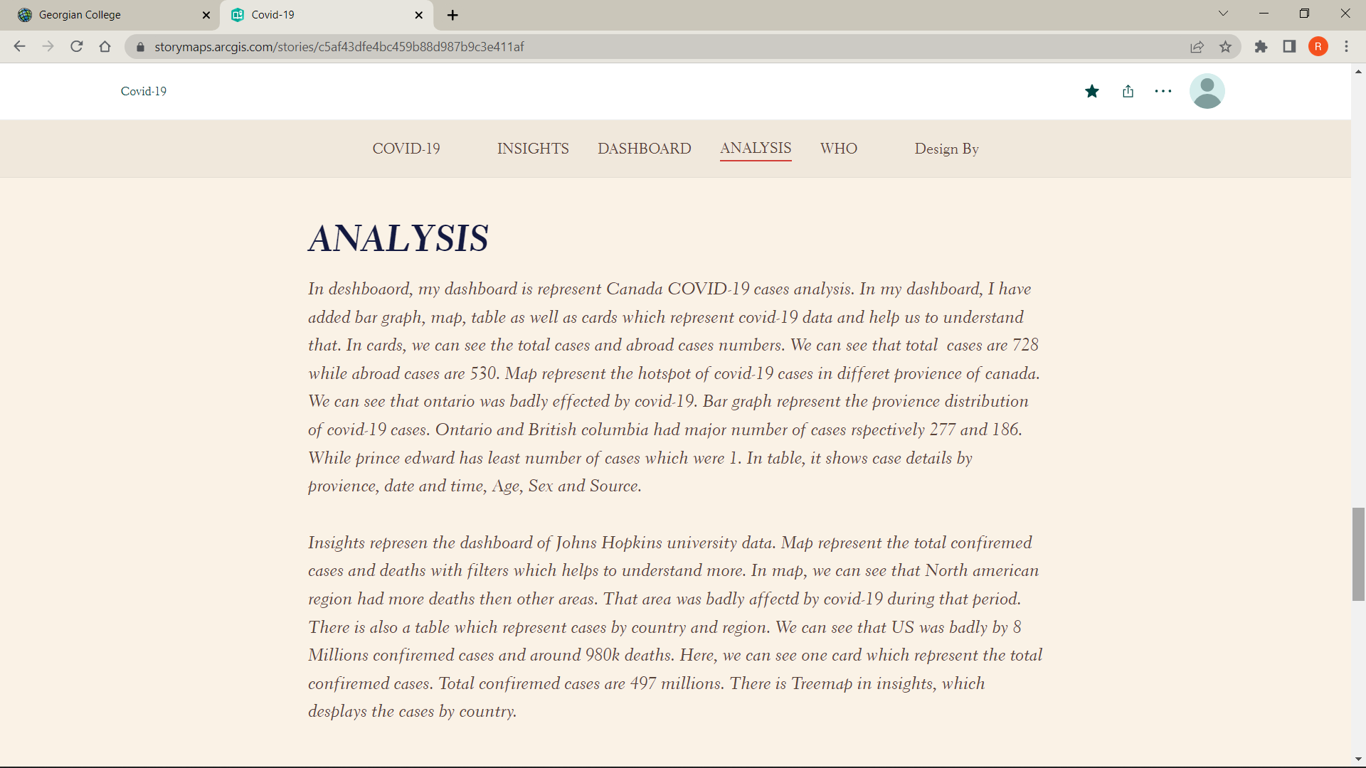

Slide 9
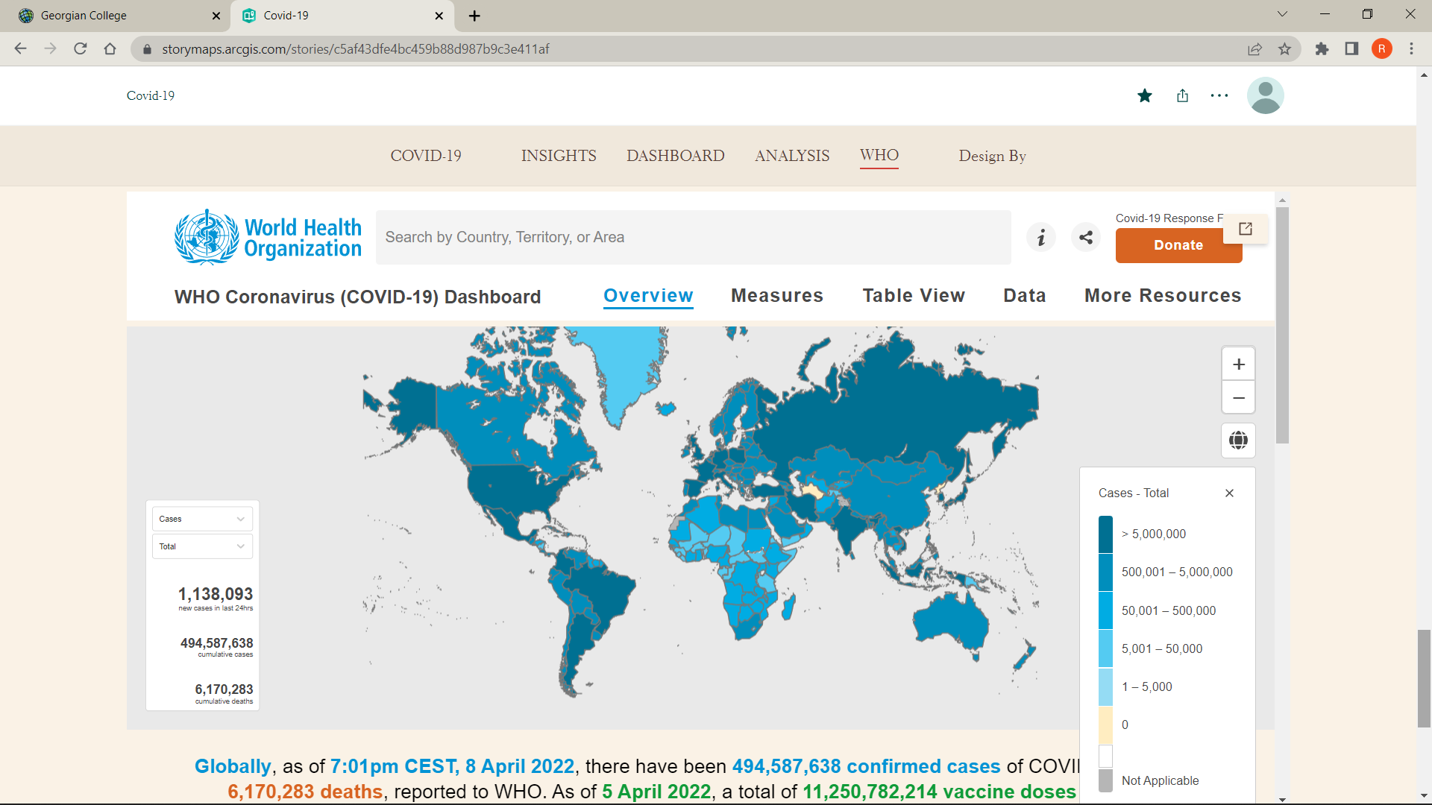

Slide 10
